Slide 1
CSCE 5520
Wireless Networks and Protocols Lecture 1: Wireless Introduction
Asif I Baba
University of North Texas
Many slides adapted form Peter Steenkiste lectures at
Carnegie Mellon University

Slide 2
Where to Look for Things
LMS (canvas)
» Lecture schedule and slides
» Office hours, contact information, …
» Deadlines for homeworks, surveys, and projects
» Handouts
Canvas is used for any course information, announcements, and handouts

Slide 3
Textbook and Readings
Textbook” "Wireless Communication Networks and Systems", Corry Beard and William Stallings, Pearson, 2015
» Best fit for the course
The course is not based on the book
» The book should be used to read about the topics covered in class, e.g., to clarify points or get more depth
» Book does not cover all material, but slides are detailed
Some additional readings will be uploaded to canvas

Slide 4
Collaboration
Traditional rules of collaboration apply
» https://vpaa.unt.edu/ss/integrity
You must complete individual assignments and tests by yourself
You are expected to collaborate with your partner in the team-based projects (if any)
It is acceptable and encouraged to help fellow students with generic problems
» e.g. where to find documentation, use of tools, ..
» You must give proper credit when reusing material

Slide 5
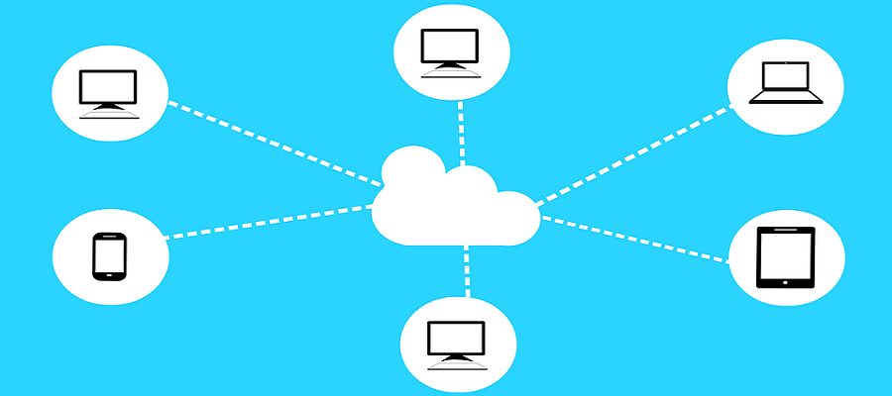
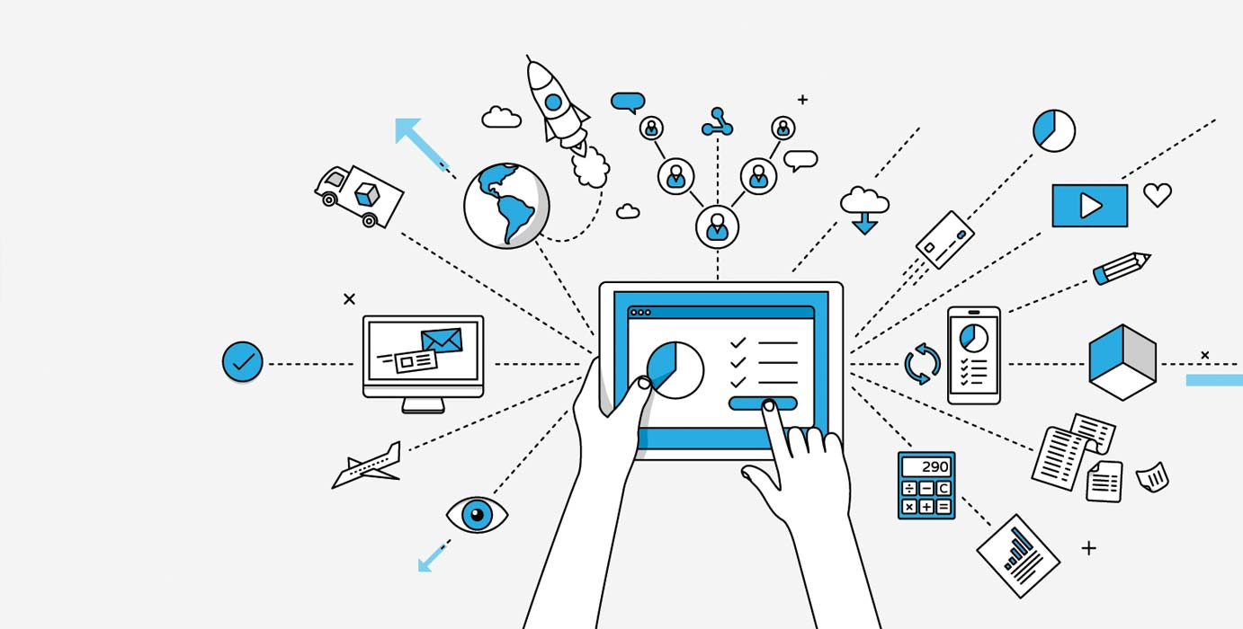


Networks are everywhere!
Almost all areas of computing are network-based
Distributed computing
Big Data
Cloud Computing
Internet of Things
Smart Cities

Slide 6
Networking is Fueling All Sectors of Economy
Networking companies are among the most valued companies: Apple, AT&T, Samsung, Verizon, Microsoft, China Mobile, Alphabet, Comcast, NTT, IBM, Intel, Cisco, Amazon, META (Facebook), …
Note: Apple became highly valued only after it switched from computing to communications (iPhone)

Slide 7
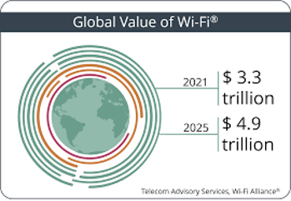
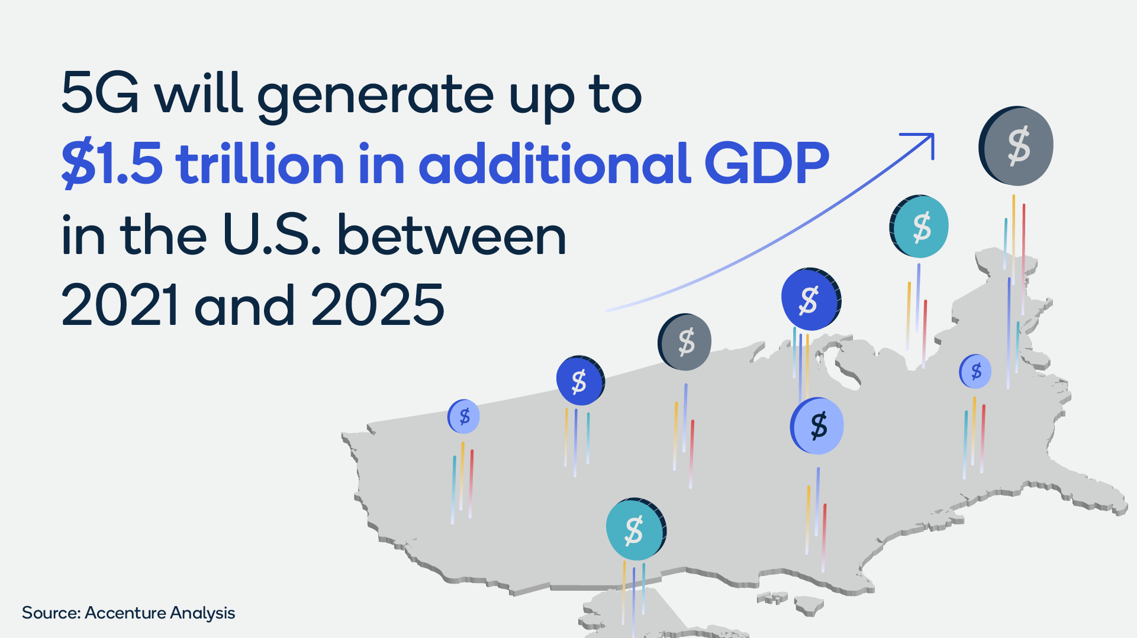
Networking is Fueling All Sectors of Economy
Wi-Fi provides significant benefits to economies worldwide. The global economic value of Wi-Fi is estimated at more than $3.5 trillion USD. By 2025 that value is expected to grow to nearly $5 trillion.
5G is poised to generate up to $1.5 trillion in additional GDP in the U.S. between 2021 and 2025, according to a new economic study by Accenture, commissioned by Qualcomm.
https://www.wi-fi.org/discover-wi-fi/value-wi-fi
https://www.axios.com/sponsored/content-item/qualcomm-how-5g-will-become-the-underlying-foundation-of-the-u-s-economy

Slide 8
Mobility vs Wireless
Mobile vs. stationary
Wireless vs. wired

Slide 9
Wireless Networking
Impact of Wireless on Networking:
Not tied to walls/infrastructure
Ad-hoc networks
Error-prone
Traffic management
Frequent Disconnections
Resource management
Quality of service for multimedia
Battery operate
Media access and networking while sleep
Broadcasting
security

Slide 10
Mobile Networking
Impact of mobility on Networking:
Location
Addressing
Handoff

Slide 11
Why Wireless networks?
Wireless (WiFi) is ubiquitous.
Most of the access (end user connectivity) is wireless
Smart phones, Tablets, and many laptops (Ultrabooks) have no wired Ethernet connections
Most of telecommunication carriers’ revenue is in wireless
New Developments:
5G: 1 Gbps Metropolitan Area Networks
Vehicular Networking (802.11p)
Cognitive networks: Sharing unused spectrum

Slide 12
Mobile Internet
Over 55% of website traffic comes from mobile devices.
92.3% of internet users access the internet using a mobile phone.
There are approximately 4.32 billion active mobile internet users.
Africa has the highest proportion of internet traffic from mobile devices - 69.13%.
There will be over 1 billion 5G connections worldwide by 2025.

Slide 13
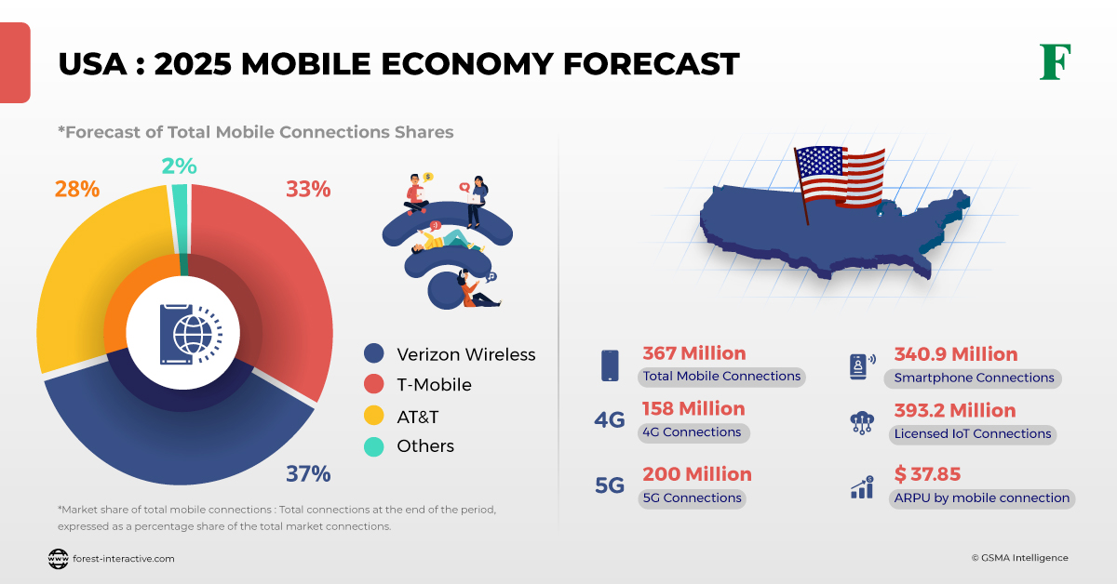
USA: 2025 Mobile Economy Forecast
USA is the second-largest market for 5G and IoT technology. The three major operators in the market (AT&T, Verizon, and T-Mobile) have made partnerships with vendors to expand their 5G technologies.

Slide 14
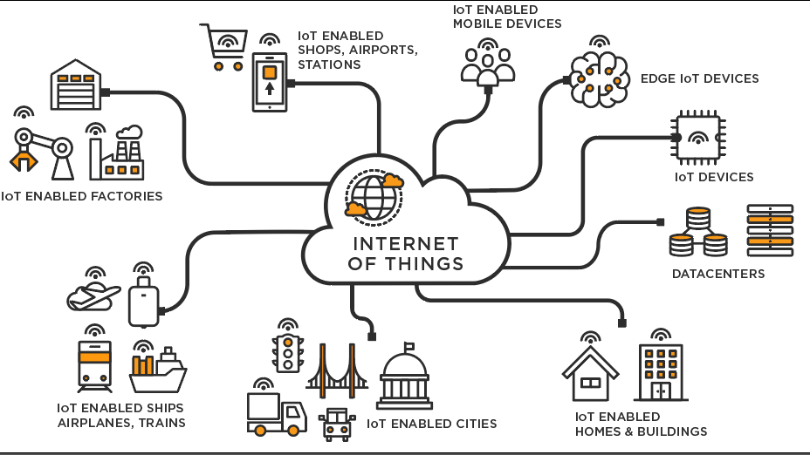
Internet of Things

Slide 15
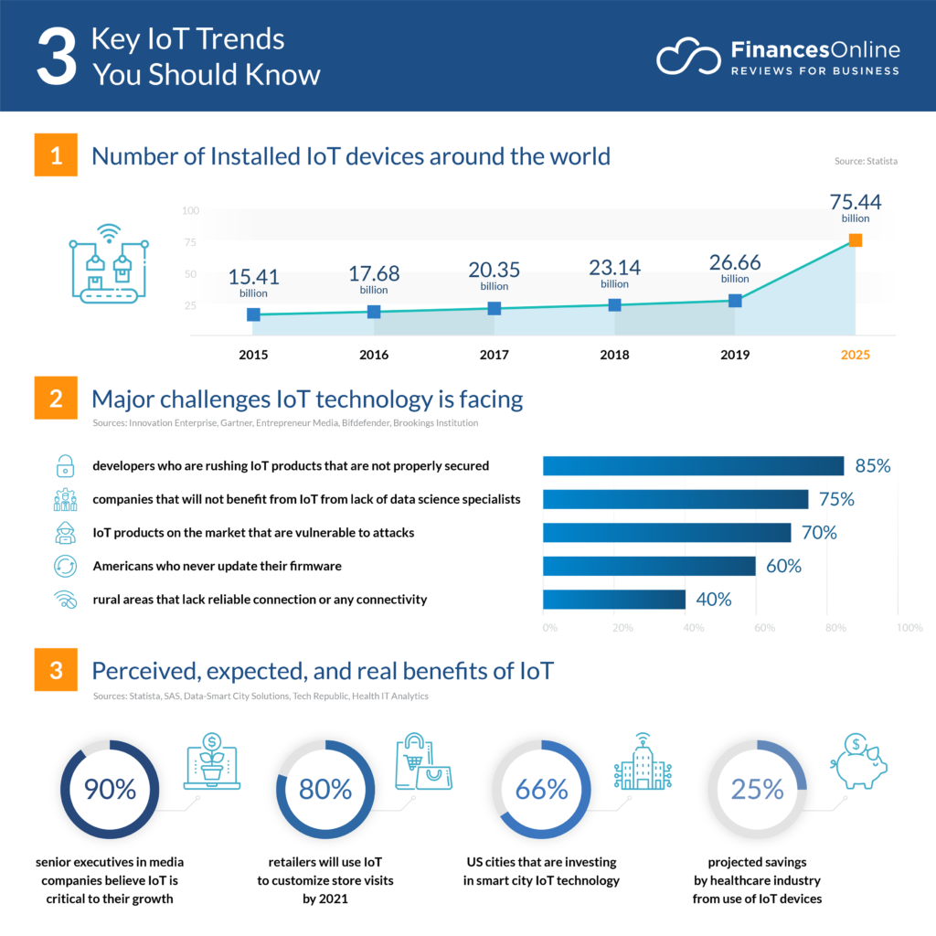

Slide 16
Wireless Communication
Transmitting voice and data using electromagnetic waves in open space
Electromagnetic waves
Travel at speed of light (c = 3x10⁸ m/s)
Has a frequency (f) and wavelength (λ)
c = f x λ
Higher frequency means higher energy photons
The higher the energy photon the more penetrating is the radiation

Slide 17
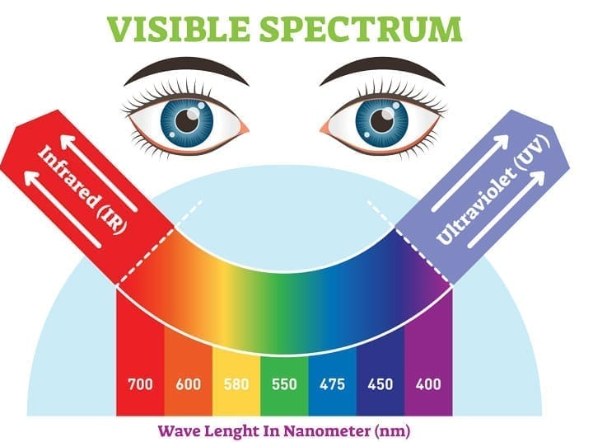
Electromagnetic Spectrum
10⁴
10²
10⁰
10⁻²
10⁻⁴
10⁻⁶
10⁻⁸
10⁻¹⁰
10⁻¹²
10⁻¹⁴
10⁻¹⁶
Radio
Spectrum
Micro wave
IR
UV
X-Rays
Cosmic
Rays
10⁴
10⁶
10⁸
10¹⁰
10¹²
10¹⁴
10¹⁶
10¹⁸
10²⁰
10²²
10²⁴
1MHz ==100m 100MHz ==1m
10GHz ==1cm
Visible light
< 30 KHz VLF 30-300KHz LF
300KHz – 3MHz MF 3 MHz – 30MHz HF 30MHz – 300MHz VHF
300 MHz – 3GHz UHF
3-30GHz SHF
> 30 GHz EHF

Slide 18
Spectrum Shared by Many Users
Spectrum allocated by FCC and NTIA
Two types of spectrum bands:
Licensed spectrum: exclusive access to an organization
Federal agencies, broadcast TV, first responders, …
Commercial, e.g., cellular operators
Unlicensed spectrum: everyone can use it with appropriate equipment, e.g., WiFi, zigbee, …
Other trends:
» Technology improvements have allowed us to use higher frequency bands over time
» Many bands have low utilization
» Older bands often use very inefficient technologies

Slide 19
Wireless Technologies
3 THz
Optical Communications satellite
Infrared Wireless LAN
IR
300 GHz
EHF
30 GHz
Communications
SHF
Terrestrial
satellite
WiMAX/LTE
microwave Experimental
Communications satellite
Wi-Fi
3 GHz
Ultra- wideband
ZigBee
UHF
Cordless phone
Cellular phone
300 MHz
Color TV
VHF
FM radio
Mobile Two-way
30 MHz
Black-and
White TV
radio
HF
Shortwave radio
1930 1940
3 MHz
1950
1960 1970
1980
1990
2000
2010

Slide 20
Why so many Technologies?
Diverse application requirements
» Energy consumption
» Range
» Bandwidth
» Mobility
» Cost
100
Technologies have different
» Signal penetration
» Frequency use
» Cost
» Market size
» Age, integration
UWB
IrDA
Diverse deployments
» Licensed versus unlicensed
» Provisioned or not
Throughput (Mbps)
10
WiFi
WiMAX/LTE
1
BT
Zigbee
1m
10m 100m 1Km
Range
10km 100km
Peter A. Steenkiste. CMU

Slide 21
Application Trends in Wireless
Early days: specialized applications
» Broadcast TV and radio, voice calls, data, ..
» Holds for wireless and wired
Today: flexible wireless platforms
» Phones, tables, and laptops all run similar applications
» Same trend as for wired networks: everything runs over the Internet
Wireless is expanding in new domains
» Sensor networks, body area networks, …
» Edge of the internet is increasingly wireless
» Many of these applications are unique to wireless
Future?

Slide 22
Scope of Wireless Covered in the Course
Significant depth on two technologies:
» Wireless in unlicensed band: WiFi
» Wireless in licensed spectrum: cellular
» Focus is on optimizing performance with limited spectrum
» Sophisticated protocols to fight challenging physical layer
Other wireless communication technologies
» RFID/NFC, low-power, sensor networks, …
Wireless deployments
» Infrastructure WiFi, ad hoc, sensor networks, vehicular, ..
Other applications of wireless
» GPS, Wifi for localization, dynamic spectrum access, …
» Other topics covered in the surveys

Slide 23
Some History…
Hertz discovered electromagnetic waves (1880)
Tesla credited with first radio communication in 1893
Wireless telegraph invented by Guglielmo Marconi in 1896
First telegraphic signal traveled across the Atlantic ocean in 1901
First “cell phone” concept developed in 1946
» FCC allocated spectrum in the 70s; commercial service in the early 80s
» Data started only in the 90s
GPS project started in 1973, complete in 1995
WiFi technology developed in the mid-1990s

Slide 24
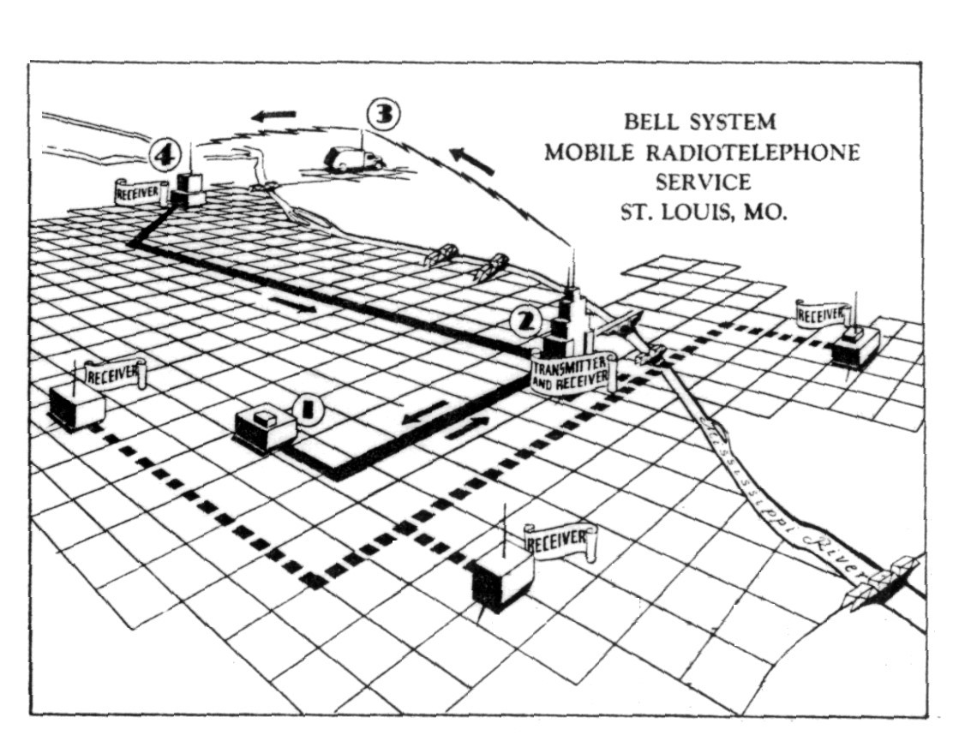
The MTS network
http://www.privateline.com/PCS/images/SaintLouis2.gif

Slide 25
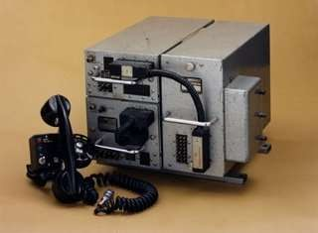

The origin of mobile phone
America’s mobile phone age started in 1946 with MTS
First mobile phones bulky, expensive and hardly portable, let alone mobile
» Phones weighed 40 Kg~
Operator assisted with 250 maximum users

Slide 26
Short History of WiFi
In 1985, the FCC opened up the 900 Mhz, 2.4 GHz and 5.8 Ghz bands for unlicensed devices
NCR and AT&T developed a WiFi predecessor called “Wavelan” starting in 1988
» NCR wanted to connect cashier registers wirelessly
» Originally used the 900 MHz band and ran at 1 Mbps
Standardization started in early 90s and led to 802.11b (1999) and 802.11a (2000)
» Pre-standard products were available earlier
Today –many standards!
» Working on 802.11ax and ay - rates up to several Gps
» Very sophisticated: OFDM, MIMO, multi-user MIMO, ..
» Multiple frequency bands: 2.4 GHz, 5 GHz, 60 GHz

Slide 27
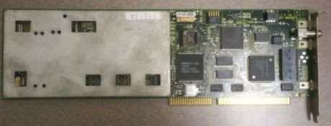
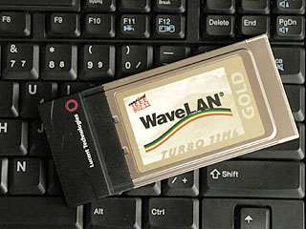
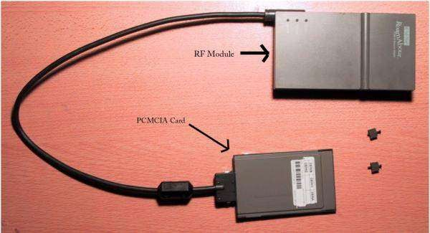
Early WiFi Interfaces
PCMCIA form factor made Wavelan more portable
Wavelan at 900MHz 1 Mbps throughput

Slide 28
Hype Cycle for Enterprise Networking and Communications, 2018

Slide 29
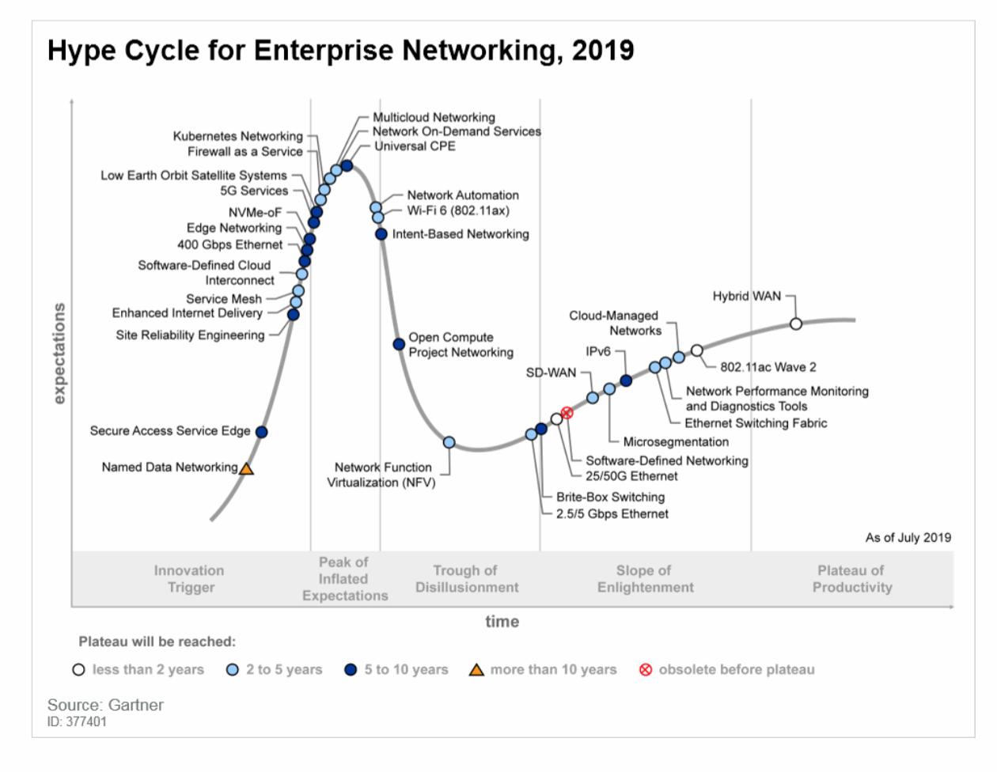

Slide 30
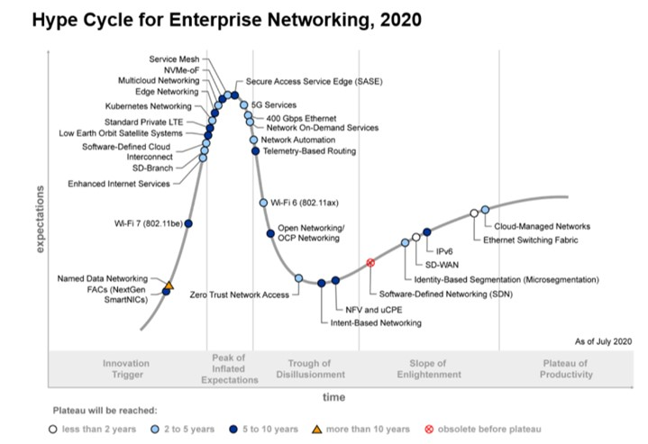

Slide 31
Outline
Goals and structure of the course
Administrative stuff
A bit of history
Wireless technologies
Building a network
» What pieces do we need
» The OSI model
» Packet-based communication
» Challenges in Wireless Networking

Slide 32
The Internet is Big and Has Many, Many Pieces
How do you design something this complex?
Application
Operating System
Operating System
Router Software (many protocols)
Application
Links
Computer
Protocol Software
Router Hardware
Network Interface
Computer
Bridge HW/SW

Slide 33
What Pieces Do We Need?
Module:
We need to be able to send bits
» Over wired and wireless links
» Based on analog signals
We really want to send packets
» Statistical multiplexing: users can share link
» Need addresses to deliver packets correctly
But network may not be reliable
» Bit errors, lost packets, …
» Must recover from these errors end-to-end
You need applications and services
» Otherwise: who cares?
Physical
Datalink Network
Transport
Application

Slide 34
Hosts Exchanging Packets can be Easy or Hard
Two or more hosts talk over a wire (bits)
Groups of hosts can talk at two levels
» Hosts talk in a network is homogeneous in terms of administration and technology
» Hosts talk across networks that have different administrators and technologies
Physical
Datalink Internet
Scaling up
Differ in physical and admin properties, scale
Internet

Slide 35
A Bit More Detail
Physical layer delivers bits between the two endpoints of a “link”
» Copper, fiber, wireless, visible light, …
Datalink layer delivers packets between two hosts in a local area network
» Ethernet, WiFi, cellular, …
» Best effort service: should expect a modest loss rate
» “Boxes” that connect links are called bridges or switches
Network layer connects multiple networks
» The Inter-net protocol (IP)
» Also offers best effort service
» Boxes that forward packets are called routers
Scaling up the network

Slide 36
Our Internet So Far
Application
The Internet as five modules that are stacked as a set of layers
» More on this later
Five layers is nice, but …
» Each module is still huge!
» What about communication?
We need protocols!
Protocol modules within each layer on different devices allow the devices communicate
Transport
Inter-network
Datalink
Physical

Slide 37






Protocol Enable Communication
Friendly greeting
An agreement between parties on how communication should take place.
Protocols must define many aspects of the communication.
Syntax:
» Data encoding, language, etc.
Semantics:
» Error handling, termination, ordering of requests, etc.
Protocols at hardware, software,
all levels!
Example: Buying airline ticket by typing.
Syntax: English, ascii, lines delimited by “\n”
Muttered reply
Get to Heinz Hall?
That way …
Thank you

Slide 38
Protocol and Service Levels
Application
Transport
Inter-network Datalink
Physical
Host
Host
LAN
LAN
Internet

Slide 39




The ISO Layered Network Model
The Open Systems Interconnection (OSI) Model.
7
6
5
4
3
2
1
Application
Presentation
Session
Transport
Network
Data link
Physical
Application
Presentation
Session
Transport
Network
Data link
Physical
Network
Data link
Physical

Slide 40
OSI Functions
(1) Physical: transmission of a bit stream.
(2) Data link: flow control, framing, error detection.
(3) Network: switching and routing.
(4) Transport: reliable end to end delivery.
(5) Session: managing logical connections.
(6) Presentation: data transformations.
(7) Application: specific uses, e.g. mail, file transfer, telnet, network management.

Slide 41
Life of Packet
Application
Presentation Session Transport Network
Data Link Physical
Host
Bridge/Switch
Router/Gateway
Host
Peter A. Steenkiste. CMU

Slide 42






A TCP / IP / 802.11 Packet
Preamble MAC header
LLC / SNAP header
Application
Presentation
Session
Transport
Network
Data link
Physical
IP header
TCP header
Data

Slide 43
Example: Sending a Web Page
Http hdr Web page
Application
Presentation
Session
Transport
Network
Data link
Physical
. . .
TCP
header
Application payload

Slide 44
OSI Motivation
Standard approach of breaking up a system in a set of components with well defined interfaces, but components are organized as a set of layers.
» Only horizontal and vertical communication
» Components/layers can be implemented and modified in isolation without affecting the other components
Each layer offers a service to the higher layer, using the services of the lower layer.
“Peer” layers on different systems communicate via a protocol.
» higher level protocols (e.g. TCP/IP, Appletalk) can run on multiple lower layers
» multiple higher level protocols can share a single physical network

Slide 45
Benefits of Layered Architecture
Significantly reduces the complexity of building and maintaining the system.
» Effort is 7 x N instead of N⁷ for N versions per layer
The implementation of a layer can be replaced _{True}
easily as long as its interfaces are respected
For
» Does not impact the other components in the system
» Different implementation versus different protocols
In practice: most significant evolution and diversity at the top and bottom:
» Applications: web, peer-to-peer, video streaming, ..
» Physical layers: optical, wireless, new types of copper
» Only the Internet Protocol in the “middle” layer
Wireless?

Slide 46
Impact of the Physical Layer
Wires:
reliable and predictable
Application Transport Inter-network Datalink
Physical
Wireless:
error prone and variable
Packet losses and variable delay and bandwidth
Disconnections
Mobility: IP addresses change
Must manage complex PHY to perform error control
Sophisticated modulation & coding, bit rate adaptation

